Slide 1
CS 204
Advanced Programming
(Binary Search Trees)
Kamer Kaya
Faculty of Engineering and Natural Sciences
Sabancı University
kaya@sabanciuniv.edu

Slide 2
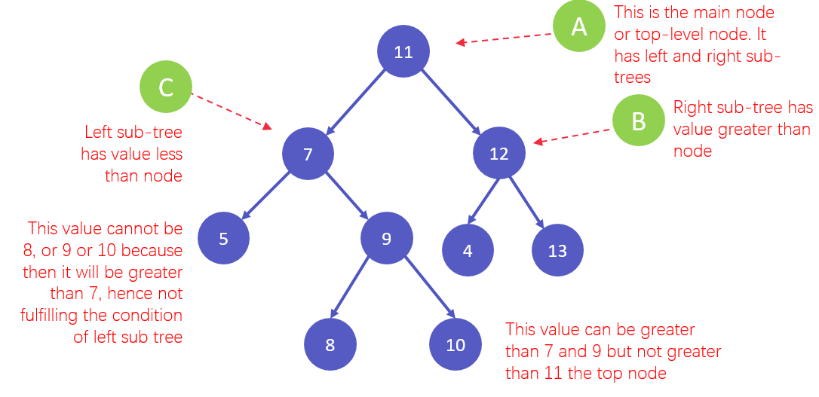
Binary Search Trees

Slide 3
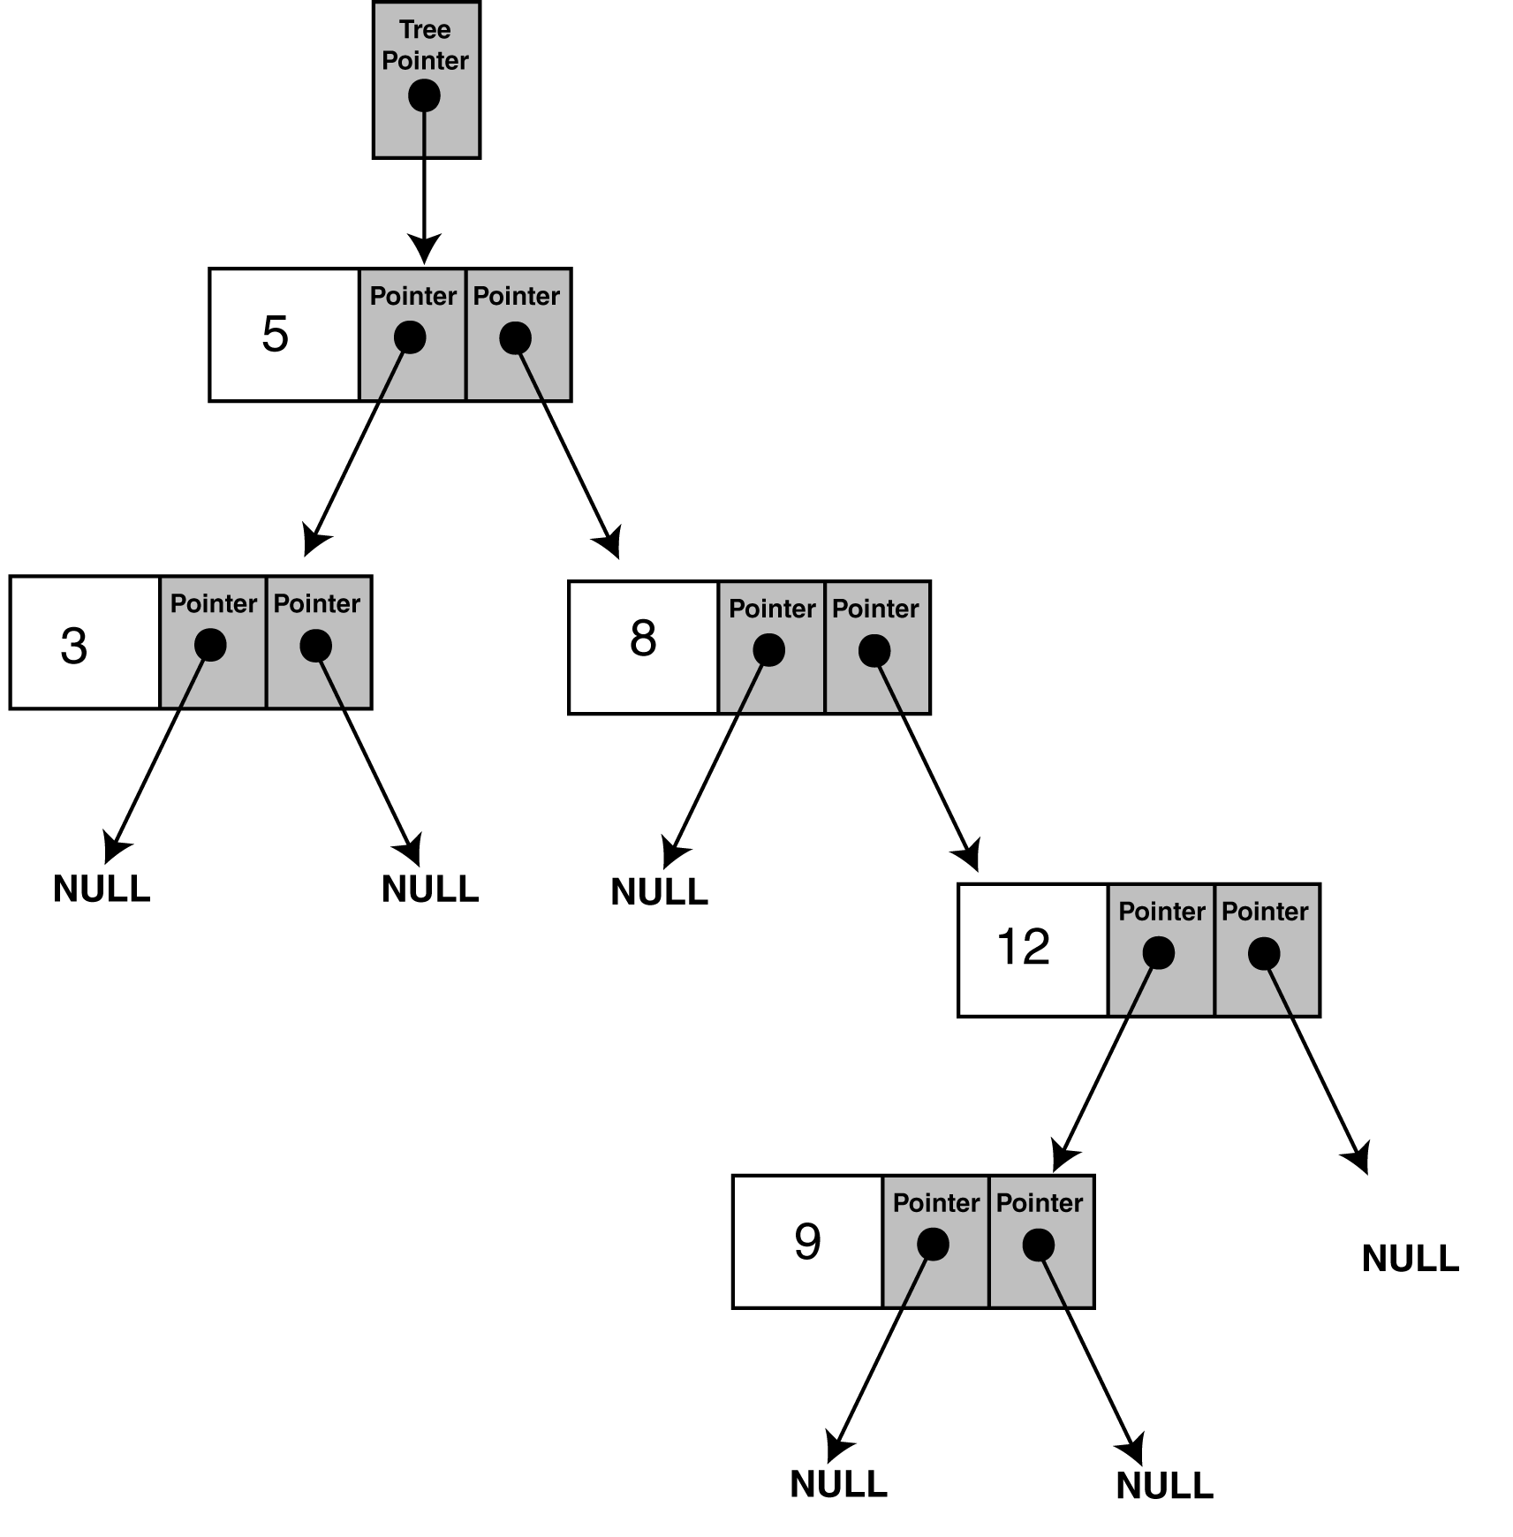
Binary Search Trees
Information is stored in binary search trees in a way that makes a binary search simple.
struct TreeNode
{
int value;
TreeNode *left;
TreeNode *right;
};
Values are stored in a binary tree so that a node's left whole subtree holds data less than the node's data, and the node's right subtree holds data greater than the node's data.

Slide 4
insertNode (sample usage)
// This program builds a binary tree with 5 nodes.
#include <iostream.h>
#include "IntBinaryTree.h“
void main(void)
{
IntBinaryTree tree;
cout << "Inserting nodes. ";
tree.insertNode(5);
tree.insertNode(8);
tree.insertNode(3);
tree.insertNode(12);
tree.insertNode(9);
cout << "Done.\n";
}

Slide 5
Inorder Traversal of a BST
The node’s left subtree is traversed.
The node’s data is processed
  For instance, it is printed to the screen
The node’s right subtree is traversed.

Slide 6
displayInOrder
void IntBinaryTree::displayInOrder(TreeNode *nodePtr)
{
//TODO: Implement this recursively
}
Inorder traversal:
3
5
8
9
12

